Slide 1
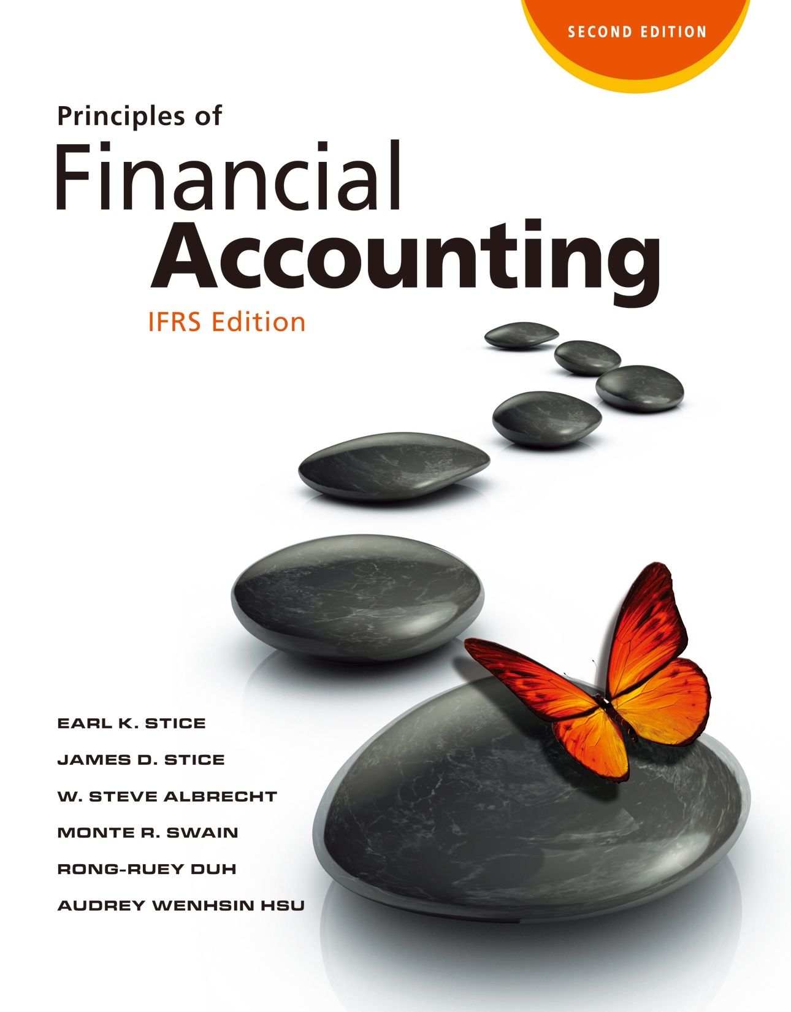

Slide 2
Accounting Information: Users and Uses

Slide 3
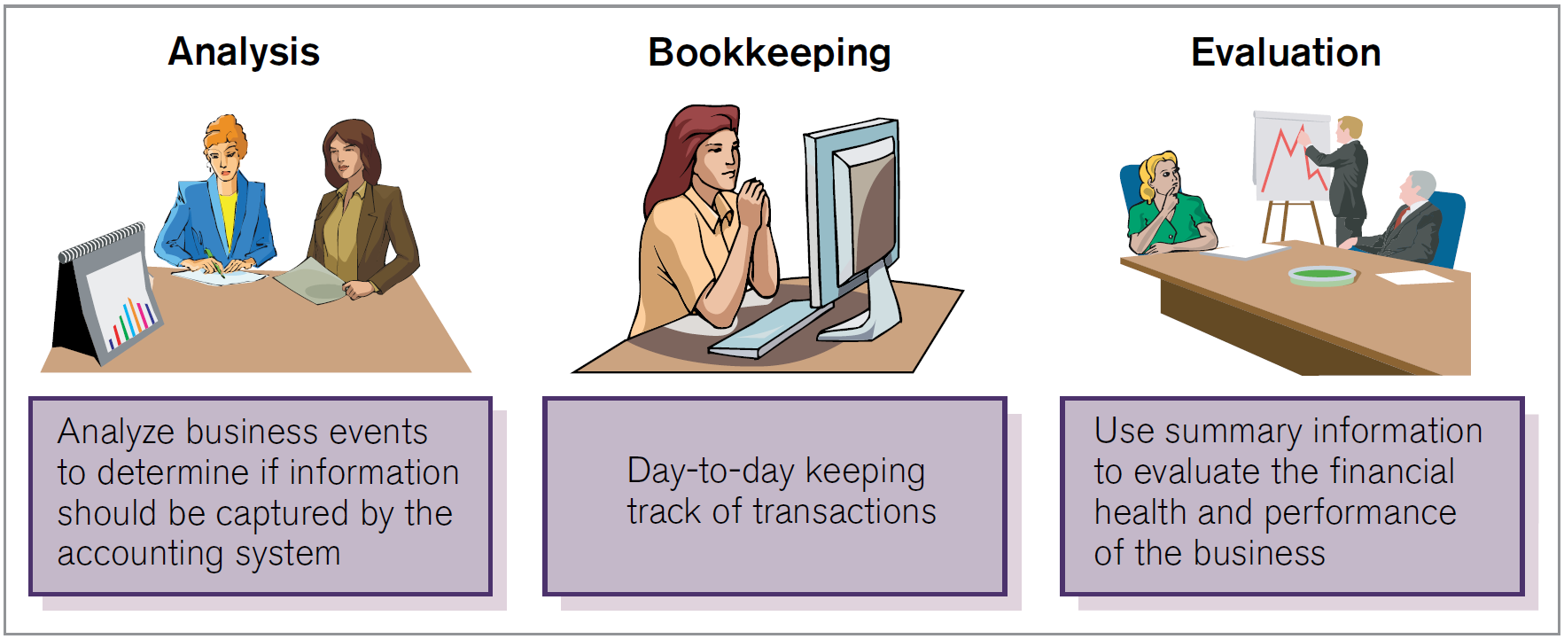
What is an Accounting System?
What’s the Purpose of Accounting?
LO1
Exhibit 1.1

Slide 4
The Purpose of Accounting
LO1
Accounting is a system for providing “quantitative information, primarily financial in nature, about economic entities that is intended to be useful in making economic decisions.”
Quantitative
Useful
Financial
Decisions

Slide 5
Distinction between Accounting and Bookkeeping
LO1
Bookkeeping | Accounting
A routine recording process subsequent to transaction analysis. | Involving the analysis of transactions (or activities).
Relating only to the recording of transactions. | Including providing information for decision-making and can affect economic consequences.
A component of accounting.

Slide 6
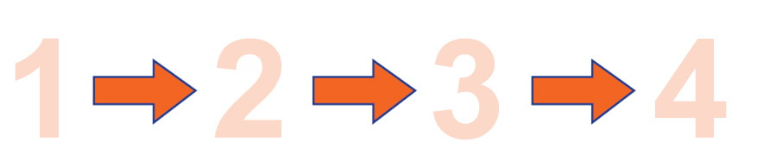
The Decision-Making Process
LO1
Step
Step
Step
Step
Identify
The issue.
Gather
Information.
Identify
alternatives.
Select the option that will most likely result in the desired objective.
Exhibit 1.2

Slide 7
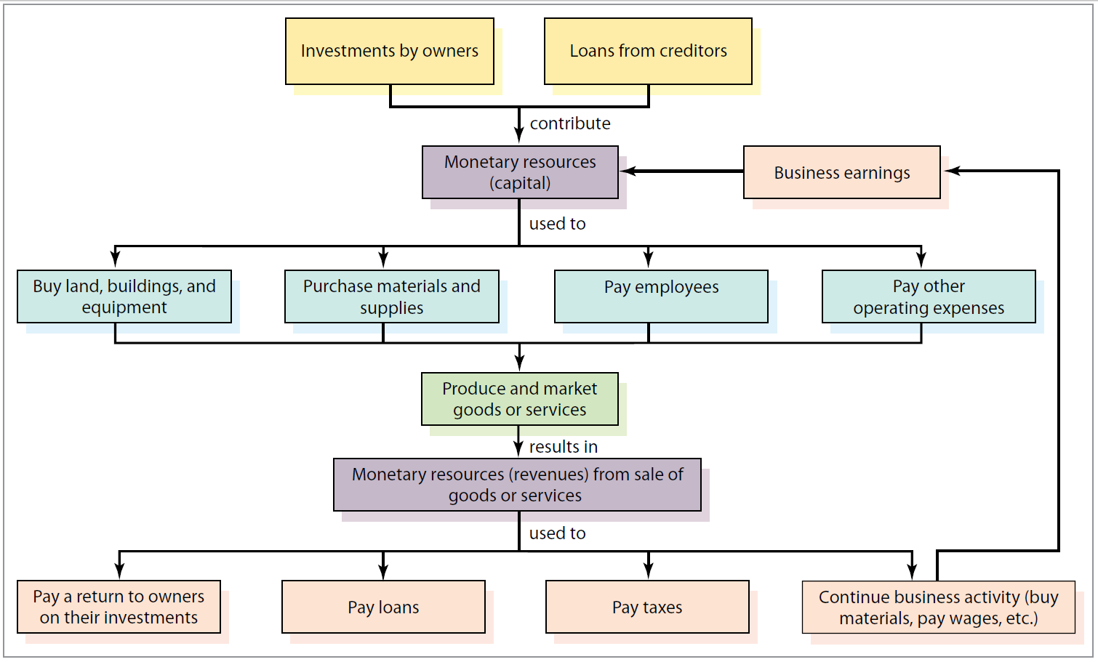
The Relationship of Accounting to Business
LO1
Activities Common
to Business
Organizations
Exhibit 1.3

Slide 8
The Relationship of Accounting to Business
LO1
Accounting is called the “language of business.”
Accounting provides information for making informed decisions about how to best use available resources.
Accountants play two roles with regard to these activities:
Measuring and reporting (follow the accounting cycle)
Advising

Slide 9
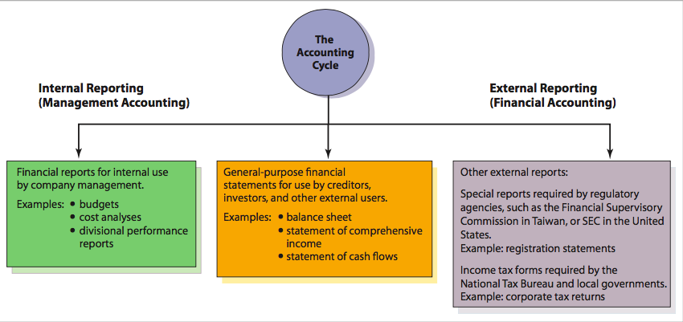
Who Uses Accounting Information?
Who Uses Accounting Information?
LO2
The accounting system generate output in the form of financial reports. There are two major categories of reports: internal and external
Exhibit 1.4

Slide 10
Who Uses Accounting Information?
LO2
Management Accounting
The area of accounting concerned with providing internal financial reports to assist management in making decisions.
Management accounting focuses on the information needed for planning, implementing plans, and controlling costs. Its information is not available to outsiders.
Financial Accounting
The area of accounting concerned with reporting financial information to interested external parties.

Slide 11
Who Uses Accounting Information?
LO2
Internal Users (Management Accounting):
– Management
Examples of Internal Reports:
Budgets
Cost analyses
Divisional performance reports

Slide 12
Who Uses Accounting Information?
LO2
External Users (Financial Accounting):
Examples of External Reports:
Annual report
General-purpose financial statements
Other regulatory reports
– Lenders (creditors) | – Employees
– Investors | – Competitors
– Management | – Government agencies
– Suppliers & Customers | – The press

Slide 13
General-Purpose Financial Statements
LO2
Primary Financial Statements
Balance Sheet
Statement of Comprehensive Income
Statement of Changes in Equity
Statement of Cash Flows

Slide 14
The Environment of Accounting
Within What Kind of Environment Does Accounting Operate?
LO3
Important factors that influence the environment in which accounting operates:
Generally accepted accounting principles (GAAP)
International business
Ethical considerations
Technology
Authoritative guidelines that define accounting practice at a particular time

Slide 15
Significance and Development of Accounting Standards
LO3
In most countries in the world, a committee or board establishes the accounting rules, which serves as the GAAP for that country.
Companies in the country then need to follow the country’s GAAP in preparing financial statements.
Using the same GAAP in the country allows users to make comparisons.

Slide 16
Accounting-Standards Setters
LO3
The International Accounting Standards Board (IASB)
To develop a worldwide accounting standards.
Prior to the IASB, the International Accounting Standards Committee (IASC) issued International Accounting Standards (IAS).Today, the IFRS and IAS and their related interpretations are collectively termed as IFRS.
International Financial Reporting Standards (IFRS)
International Accounting Standards (IAS)

Slide 17
Accounting-Standards Setters
LO3
The Financial Accounting Standards Board (FASB)
The private organization responsible for establishing the standards for financial accounting and reporting in the United States. The FASB has no legal power to enforce the accounting standards it sets.
Get its authority to establish rules from the Securities and Exchange Commission (SEC).
The accounting rules is described as GAAP in the United States.

Slide 18
Other Organizations
LO3
Securities and Exchange Commission (SEC)
The government body responsible for regulating the financial reporting practices of most publicly owned corporations in connection with the buying and selling of stocks and bonds.
American Institute of Certified Public Accountants (AICPA)
The national organization of CPAs in the United States.
Internal Revenue Service (IRS)
A government agency that prescribes the rules and regulations that govern the collection of tax revenues in the United States.
Companies must maintain two sets of books: financial accounting and tax accounting

Slide 19
International Business
LO3
The international nature of business requires companies to be able to make their financial statements understandable to users all over the world.
A set of worldwide accounting standards such as IFRS was created to alleviate this complication.

Slide 20
Ethics in Accounting
LO3
The accounting scandals: Enron, WorldCom, and Tyco.
The creation of the PCAOB is an example of the SEC’s intent to ensure the quality of reported financial information.
The Auditing Standards Board and the major stock exchanges took similar measures to restore the image of the accounting professional as ethical.
Ethics is involved in preparing and using financial information. Accountants are perceived by the public as being responsible for ensuing misrepresentation does not occur.

Slide 21
Technology
LO3
Computer technology allows companies to
Easily gather vast amounts of information about individual transactions.
Compile large amounts of data quickly and accurately, thereby significantly reducing the likelihood of errors.
Lenders and investors are able to acquire and analyze financial information in an effective and efficient manner.
Technology has not replaced judgment.

Slide 22
Why Should I Study Accounting?
So, Why Should I Study Accounting?
LO4
Everyone Makes Financial Decisions
Budgeting
Buying vs. leasing
Investing
Financing
FYI
The AICPA provides a Web site that introduces students to career opportunities in accounting. The Web site is http://www.startheregoplaces.com.

